Slide 1
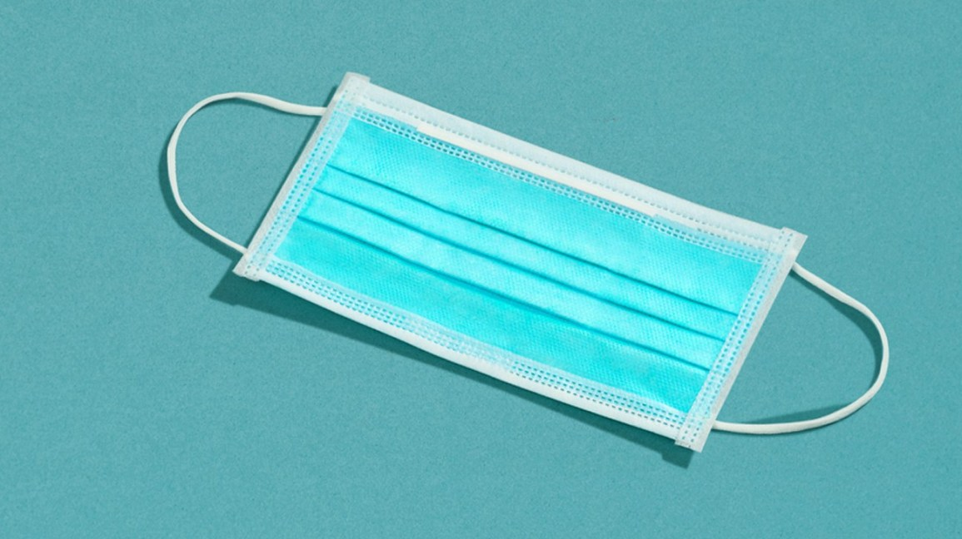
FACE MASK DETECTION
Created by: Dody Harianto

Slide 2
BUSINESS BACKGROUND

Slide 3

Background
The Covid19 outbreak has affected billions of people around the world. Wearing a mask has become an obligation nowadays. In fact, there are still many disobediences to the rule.
As a Data Scientist, I have a responsibility to build a Deep Learning model to perform face mask detection.

Slide 4

Business Objective
The objective of this project is to predict whether a person wears a mask, does not wear mask, or wears mask in incorrect way.
The main business benefit is to help generate alert or reminder if there is any violation to the rule of wearing mask in fast and automatic way.

Slide 5

Expected Output
The expected of this face mask detection project is the prediction of one of these categories:
with_mask,
mask_incorrectly_worn, or
without_mask.

Slide 6
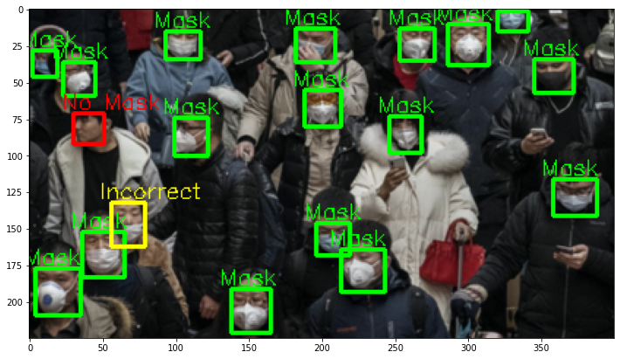
Illustration of Labels

Slide 7

Project Limitation
One of the approaches that is used is cropping an image into several images based on number of people. So, this project only focuses on predicting whether 1 person wears a mask. The limited ability of the model is to conduct multiple object detection.

Slide 8
Analytic Approach
Deep Learning Technique
Convolutional Neural Networks (CNN) for image classification.
Model Performance Measure
Recall
Precision
F1 Score
Accuracy

Slide 9
DATA UNDERSTANDING & EXTRACTION

Slide 10


Data Description
The dataset size is 398.53 MB and has 1706 files.
There are two initial directories in the dataset: Annotations and Images, with 853 files in each folder.
ANNOTATIONS
IMAGES
x 853
x 853

Slide 11
Extraction Process
ANNOTATIONS
File Name (.xml), Bounding Box, Height, Width, Label
DATA FRAME
IMAGES
File Name (.png)

Slide 12
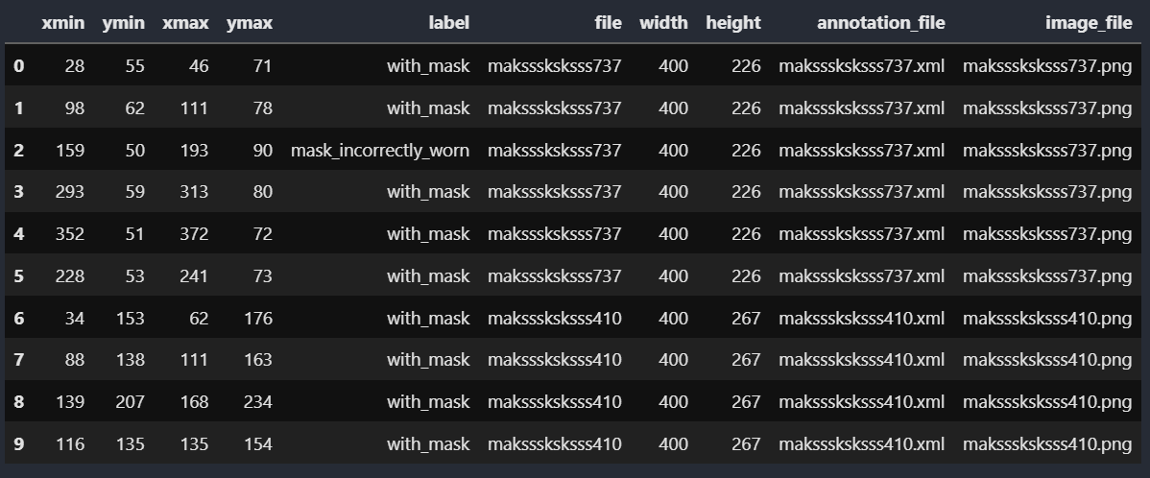
Data Frame Overview

Slide 13

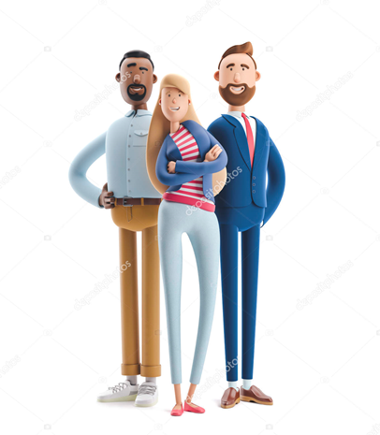



Extraction Process (Continued)
CROPPED IMAGE
FULL IMAGE
CROPPED IMAGE
CROPPED IMAGE

Slide 14

Extraction Process (Continued)
CROPPED IMAGE
CROPPED IMAGES FOLDER
CROPPED IMAGE
CROPPED IMAGE
TRAIN DATA (3272 IMAGES)
TEST DATA (800 IMAGES)

Slide 15
EXPLORATORY DATA ANALYSIS

Slide 16
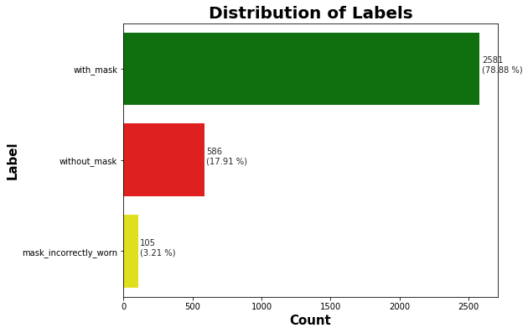
Labels Distribution

Slide 17
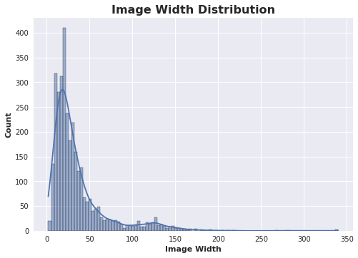
Image Width Distribution

Slide 18
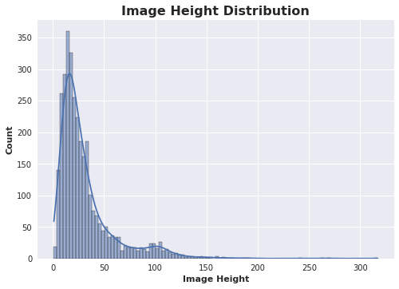
Image Height Distribution

Slide 19
Image Width & Height Statistics
Image Width
Min : 2
Max : 340
Mean : 35.7
Median : 24.0
Image Height
Min : 1
Max : 317
Mean : 31.6
Median : 22.0

Slide 20
DATA PREPROCESSING AND MODELLING

Slide 21
Image Data Generator
One of the parameters that we need to set in Keras’ Image Data Generator’ is the target size.
Based on previous visualizations, we can take either the mean or median, but since there are images with large size, we simply take the mean because it will make the model perform better.
Target Size = (35, 35)

Slide 22
Baseline Model Description
Loss : Categorical Cross Entropy
Optimizer : Adam
Metrics : Recall, Accuracy
Epochs : 100
Callbacks : Early Stopping, TensorBoard
Layers : 2 Conv2D Layer
1 MaxPool2D Layer
2 Conv2D Layer
1 MaxPool2D Layer
1 Flatten Layer
1 Output Layer

Slide 23
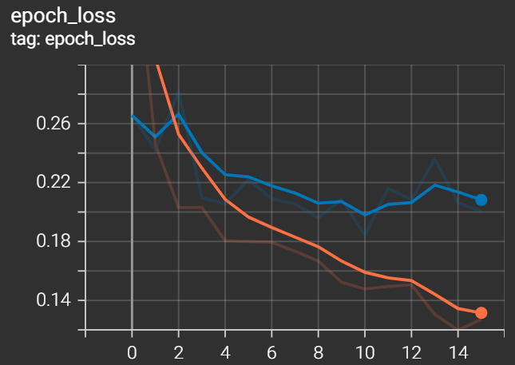
Baseline Model Loss

Slide 24
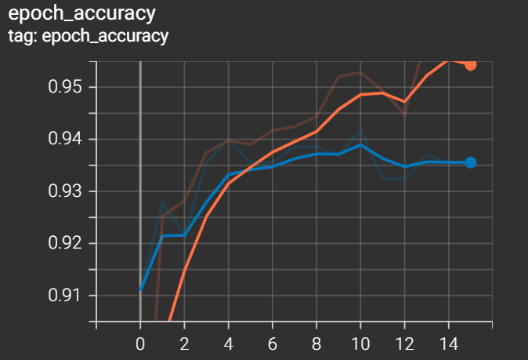
Baseline Model Accuracy

Slide 25
ResNet Model Description
Loss : Categorical Cross Entropy
Optimizer : Adam (Learning Rate = 0.001)
Metrics : Recall,
Precision,
Accuracy,
F1Score
Epochs : 150
Callbacks : Early Stopping, TensorBoard
Layers : Feature Extractor Layer,
Output Layer

Slide 26
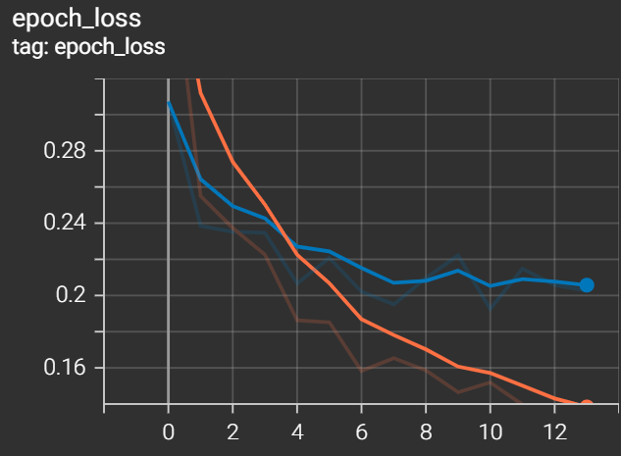
ResNet Model Loss

Slide 27
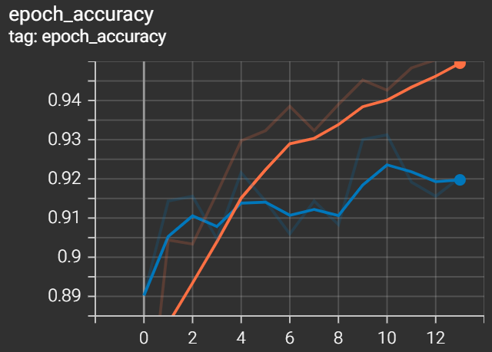
ResNet Model Accuracy

Slide 28
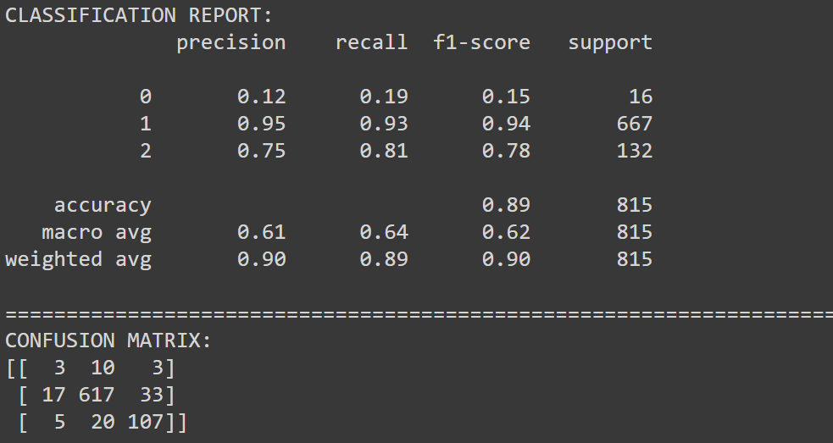
ResNet Model Report

Slide 29
EfficientNet Model Description
Loss : Categorical Cross Entropy
Optimizer : Adam (Learning Rate = 0.001)
Metrics : Recall,
Precision,
Accuracy,
F1Score
Epochs : 150
Callbacks : Early Stopping, TensorBoard
Layers : Feature Extractor Layer,
Output Layer

Slide 30
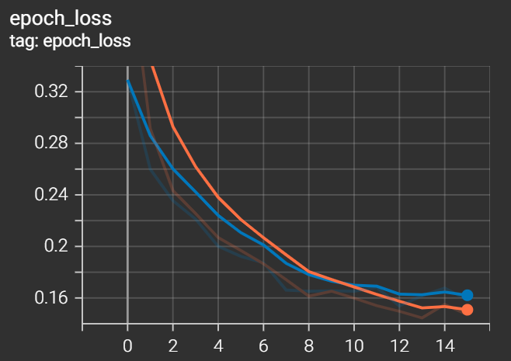
EfficientNet Model Loss

Slide 31
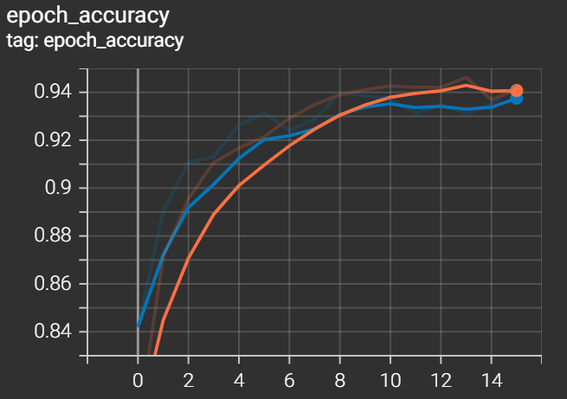
EfficientNet Model Accuracy

Slide 32
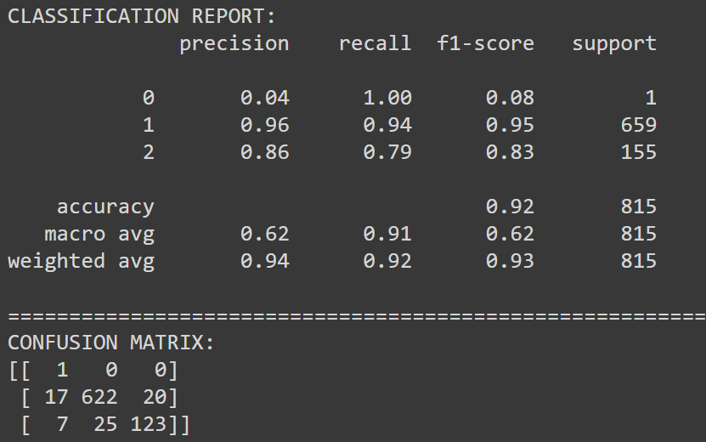
EfficientNet Model Report

Slide 33
CONCLUSION AND RECOMMENDATION

Slide 34

Conclusion
Pre-Trained models such as ResNet and EfficientNet perform better than the model that built from scratch.
EfficientNet model is less overfit compared to other models.
Image Augmentation plays a really important role in increasing the model performance.
However, the model has limited ability to predict the “mask_incorrectly_worn” class, due to extreme class imbalance.

Slide 35
Recommendation
There are several improvements that can be done in order to make this project better:
Multiple Object Detection
Multiple object detection will increase the flexibility if there are many people in an image.
CCTV Integration in Public Places
CCTV integration with real-time prediction as well as percentage of prediction confidence will help detect people without mask.

Slide 36
THANK YOU!
Questions? Email me at:
dody.harianto@binus.ac.id

